Slide 1
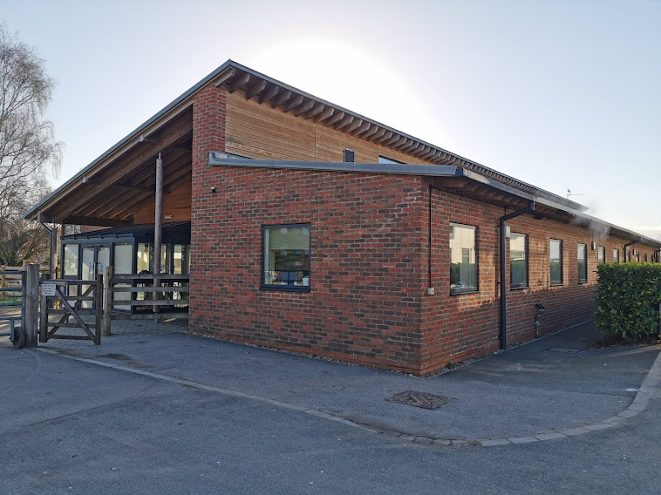
Welcome to the Minster Provision at Askham Bryan College!

Slide 3
Thank you for watching. Please come to visit us! ☺

